Slide 1


Wings of Fire: An Autobiography by A.P.J. Abdul Kalam

Slide 2

Who is A.P.J Abdul Kalam?
  An inspiring autobiography of Dr. A. P. J. Abdul Kalam, known as the Missile Man of India.
  Chronicles his journey from a humble background to a renowned scientist and the 11th President of India.
  Highlights his determination, hard work, and contributions to India's space and missile program

Slide 3
CHAPTER ONE
Family Background
  Dr. Avul Pakir Jainulabdeen Abdul Kalam.
  Born into a middle-class Tamil Muslim family in Rameswaram, Tamil Nadu.
  Father- Jainulabdeen, known for spiritual wisdom and generosity.
  Mother- Ashiamma, known for hospitality.
  A secure childhood with all necessities met despite a simple lifestyle.

Slide 4

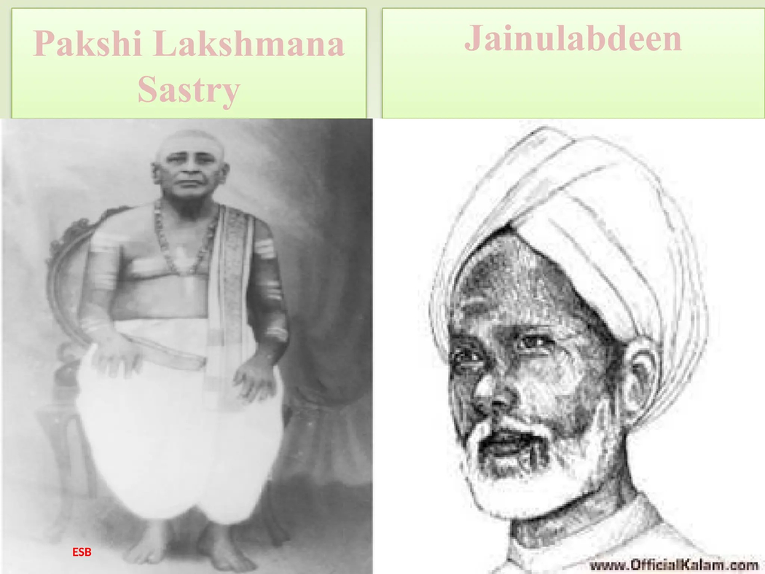


Slide 5
CHAPTER ONE
  Rameswaram was a place of religious harmony.
  Dr. Kalam experienced religious harmony and respect for all faiths from an early age.
  Father’s teachings emphasized prayer, unity of religions, and facing adversity.
  Dr. Kalam admired his father's ability to explain profound spiritual concepts simply.

Slide 6
CHAPTER ONE
  Dr. Kalam's father, Jainulabdeen, was a close friend of Pakshi Lakshmana Sastry, the high priest of the Rameswaram temple.
  Dr. Kalam and his three childhood friends Ramanadha Sastry, Aravindan, and
  Sivaprakasan--orthodox Hindu Brahmin
  families.
  Despite religious differences, they shared a
strong and unbreakable bond.

Slide 7
CHAPTER ONE
  Dr. Kalam --- when he was six years old, his father undertook an important project—the construction of a wooden sailboat.
  The sailboat was built to transport pilgrims from Rameswaram to Dhanuskodi.
  Cyclone with winds exceeding 100 miles per hour swept away their sailboat.
  The cyclone severely damaged the area, causing the Pamban Bridge to collapse.

Slide 8
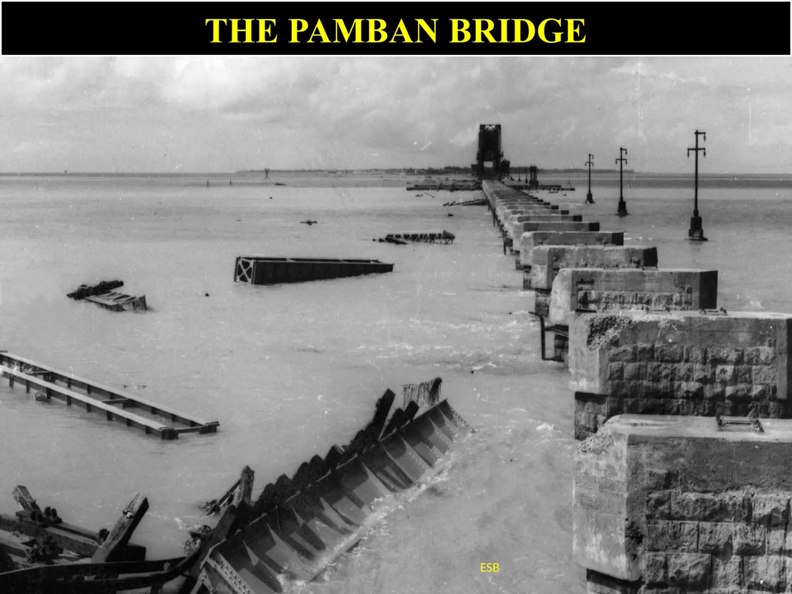


Slide 9
CHAPTER ONE
  Ahmed Jallaluddin was about 15 years older than Dr. Kalam.
  He affectionately called him Azad.
  Dr. Kalam admired Jallaluddin’s wisdom and humility, which greatly influenced him.
  Jallaluddin later married Dr. Kalam's sister, Zohara.

Slide 10
CHAPTER ONE
  Dr. Kalam also recalls the impact of his first cousin, Samsuddin, who was the sole distributor of newspapers in Rameswaram.
  Samsuddin collected newspapers from the
  Rameswaram station, which arrived from Pamban.
  He then distributed them to the literate population.
  Dinamani was the most sought-after newspaper in
  their locality.

Slide 11
CHAPTER ONE
  World War II (1939): Dr. Kalam was 8 years old when the war began.
  Tamarind Seed Business: He collected and sold tamarind seeds, earning one anna per day.
  Impact on Rameswaram: Although not directly affected, India’s involvement caused an emergency.
  Newspaper Delivery: Trains did not stop at Rameswaram; Kalam helped his cousin Samsuddin catch newspapers thrown from moving trains.
  First Earnings and Pride: He earned his first wages through this task, which made him very proud even years later.

Slide 12
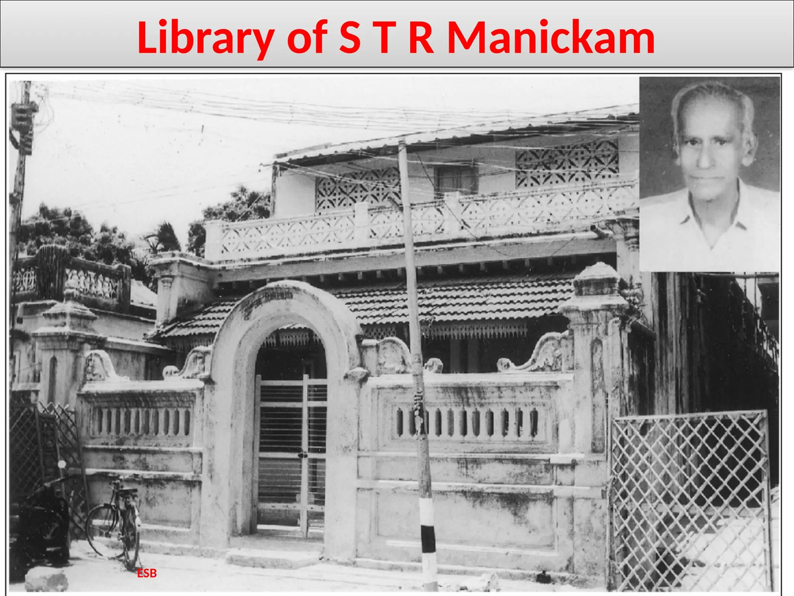

Slide 13
CHAPTER ONE
  STR Manickam's personal library provided Dr. Kalam with access to books that were otherwise unavailable in his local community.
  The books in the library, influenced by Manickam's background as a revolutionary nationalist, exposed Kalam to ideas of patriotism, courage, and selfless service to the nation.
  Reading diverse books expanded Dr. Kalam's understanding of science, history, and leadership, Shaping his aspirations and worldview.

Slide 14
CHAPTER ONE
  Experiences of Discrimination: Faced social discrimination at school due to religion.
  Resolved by Ramanadha Sastry’s father condemning the act.
  Science teacher, Sivasubramania Iyer, defied norms by inviting Kalam home.

Slide 15
CHAPTER ONE
  Dr. Kalam’s early life was shaped by values of unity, tolerance, and perseverance.
  His upbringing laid the foundation for his achievements and philosophy in life.

Slide 16
Chapter Two
  Mr. Iyadurai Solomon, Dr. Kalam's teacher, shaped his character and dreams by stressing desire, belief, and expectation.
  His guidance helped Kalam overcome humble beginnings with confidence.
  Mr. Solomon encouraged Kalam's fascination with flight, leading him to fly first from Rameswaram.
  He taught Kalam that faith and determination can change destiny.

Slide 17
Chapter Two
  Dr. Kalam pursued higher education at St. Joseph's College, Trichy.
  He was not an outstanding student academically but had a practical mindset that helped him succeed.
  During visits home, he helped his elder brother, Mustafa Kamal at his provision store, gaining practical knowledge.
  He fondly remembers Reverend Father T.N. Sequeira's
  kindness and the friendships he made at the hostel.

Slide 18
Chapter Two
  Kalam pays tribute to his mathematics teachers, Professors Thothathri Iyengar and Suryanarayana Sastry.
  Passion for English literature ---Tolstoy, Scott, and Hardy.
  Fascination with subatomic physics is ignited by his
  teachers, who introduced him to the concepts of half-life and radioactive decay.
  He also mentions the financial struggles he faces and the sacrifices made by his family, particularly his sister

Slide 19
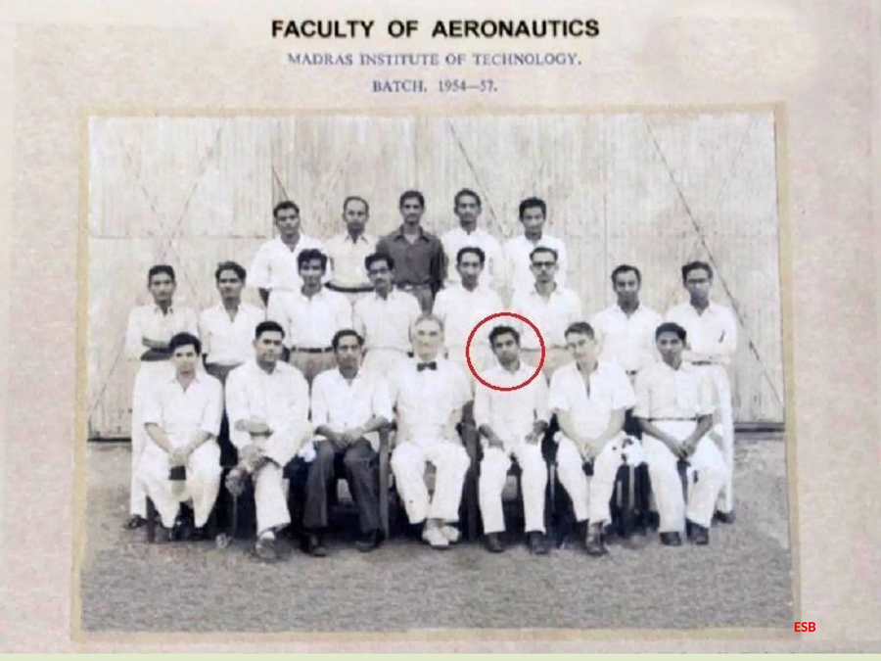


Slide 20
Chapter Two
  At MIT, Kalam --- inspired to pursue aeronautical engineering by the sight of decommissioned aircraft.
  Prof. Sponder_--- technical aerodynamics and inspires him with practical experience and professionalism.
  Prof. K.A.V. Pandalai ---- aero-structure design, making complex subjects easy to understand.
  Prof. Narasingha Rao_--- theoretical aerodynamics, sparking Kalam's interest in mathematical physics.

Slide 21
Chapter Two
  Dr. Kalam -- training program at Hindustan Aeronautics Limited (HAL) in Bangalore, gaining hands-on experience.
  After completing his training, he had two job opportunities: one in the Air Force and the other at DID&P, Ministry of Defense.
  He applied for both positions and received interview calls from both simultaneously.

Slide 22

Thank You!

